Slide 1

TITLE OF THE PROJECT
ECCENTRIC NETWORK
FOR INTRANET

Slide 2
www.Chatanasprojects.com www.1000projects.com www.Projects-forum.com

Slide 3
INTRODUCTION
This Eccentric used mainly in software company
Employee should complete they work and code should store in main server it is continues process
The day to day task is assigned by the project leader if he was not in office the can’t perform
So we created private network for them and the complete work assigned by leader
Clients can interact with this network

Slide 4
Existing System:
The current system is manual one where in the company the project leader intimates the day-to-day task. And the communication and event news over the work group is also manual. If the project leader is not present then the total work is attenuated. It needs to be loss for the company.
Due to this problem here we develop separate network for the organization employees will communicate by means of offline messages and they share documents.

Slide 5
Proposed System:
This eccentric network is developing a common interface for different sections of the development firm. This system provides help in managing different projects as well as the members associated with the work instant status of involvements of a person in the task. It provides all the available members to be part of the team and easy selection procedure to make them available when required. It also provides security to the confidential information. It reduces the redundancy of making the entries of the activities, which are done manually. It speeds up the processing with firm.

Slide 6
Scope of the Study
We divide the total project into two modules they are
User Interaction module
Internal Interaction module
[1] Admin
[2].Project Leader
[3].Project Member
        [4]. Client

Slide 7
MODULE -1
User Interaction module
User
Interaction
module
About login
Login
About Eccentric
Events
Achievements
Forgetting of
password
Internal
Interaction
Module

Slide 8
MODULE -2
Internal Interaction module
Admin
Internal Interaction module
Clients
ADMIN
Project
Leader
Project
Member
Compose
Inbox
Sent Items
Work
Space
People
Finder
News
Forms
Details
Of
User
About
Admini
stration
Project
Project,Employee,
clients

Slide 9
MODULE -2
Internal Interaction module
Project Leader
Project Leader
Compose
Inbox
Sent Items
Work
Space
People
Finder
News
Forms
Details
Of
User
About
Project

Slide 10
MODULE -2
Internal Interaction module
Project Member
Project Member
Compose
Inbox
Sent Items
Work
Space
People
Finder
News
Forms
Details
Of
User
About
Project

Slide 11
MODULE -2
Internal Interaction module
Clients
Clients
Compose
Inbox
Sent Items
Work
Space
People
Finder
News
Forms
Details
Of
User
About
Project

Slide 12
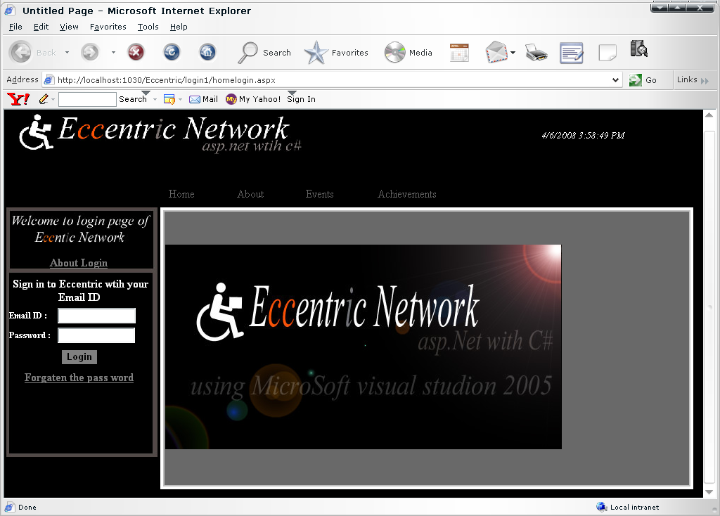

Slide 13
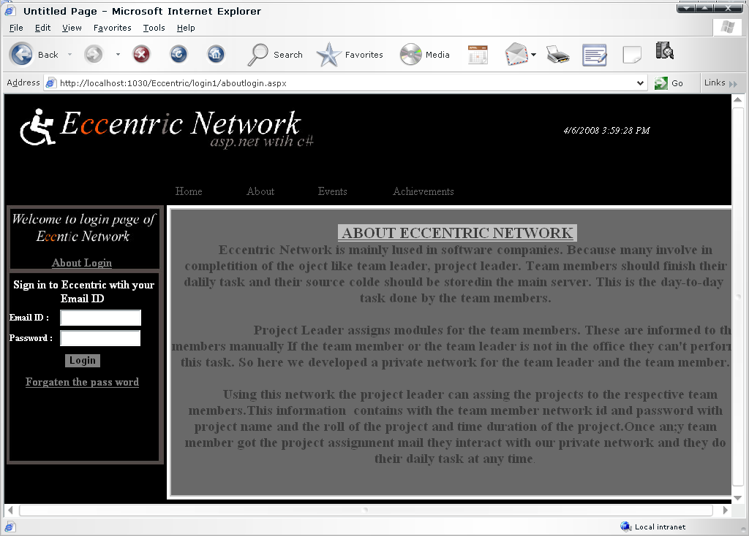

Slide 14
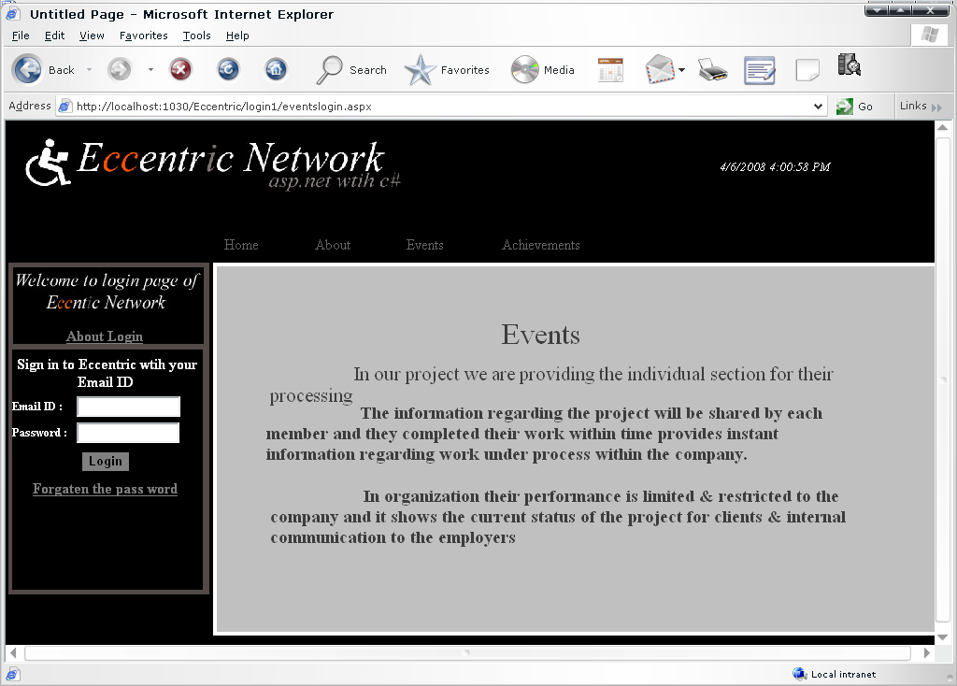

Slide 15
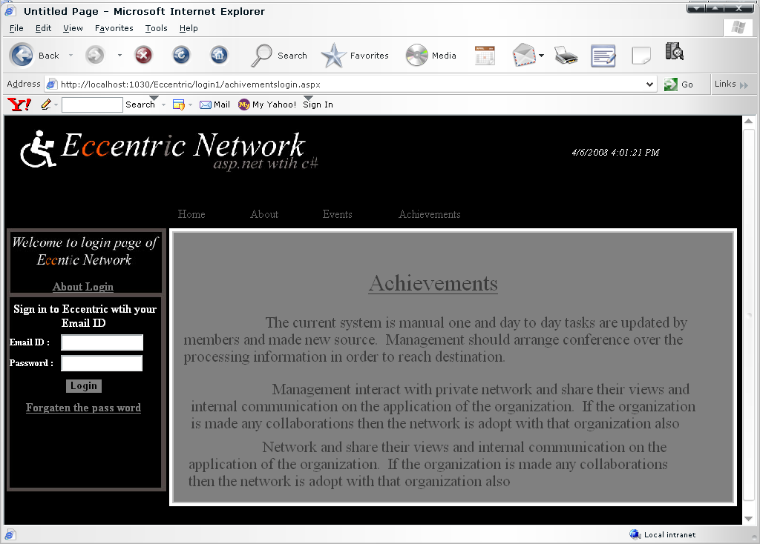

Slide 16
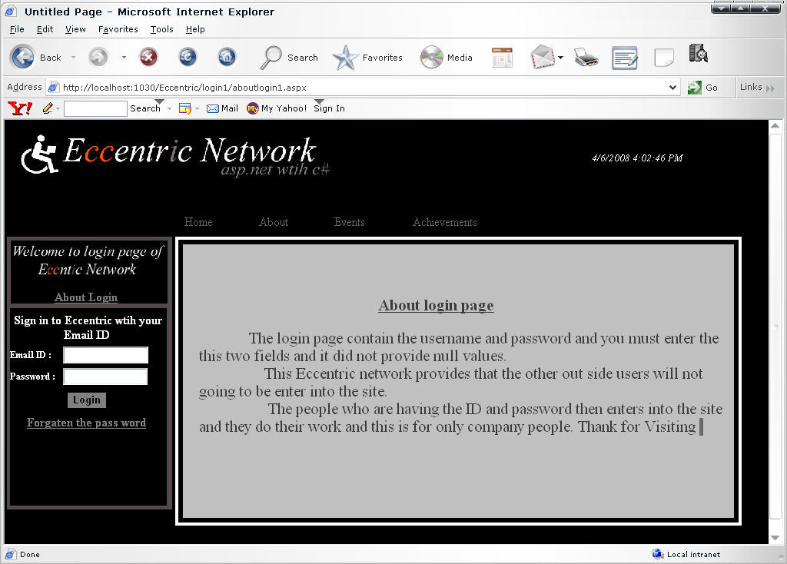

Slide 17
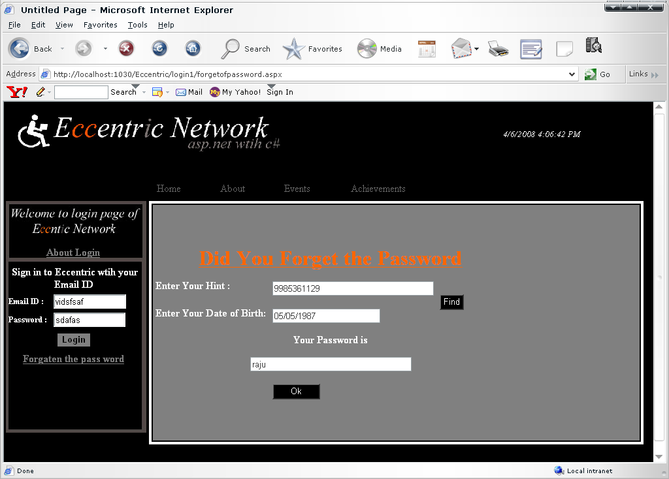

Slide 18
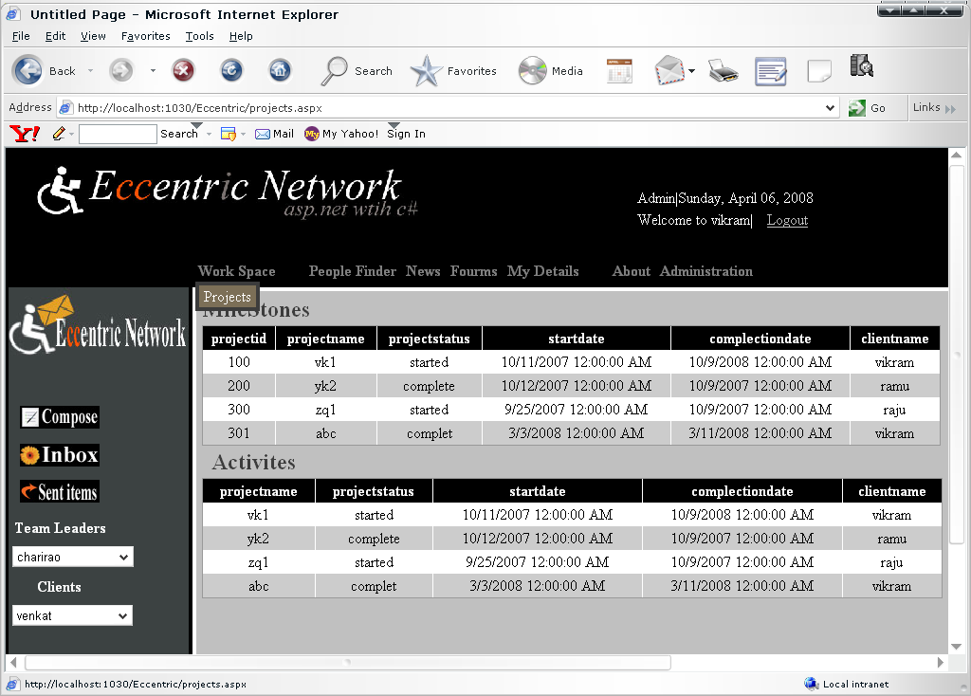

Slide 19
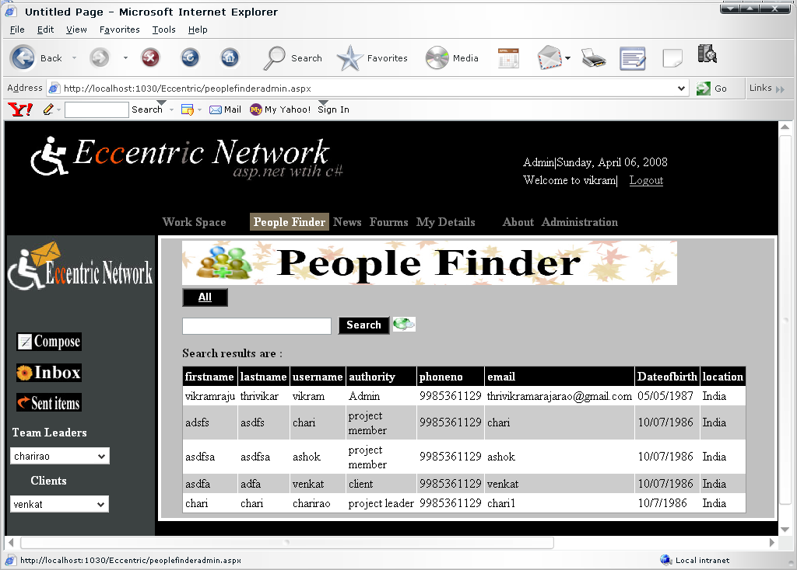

Slide 20
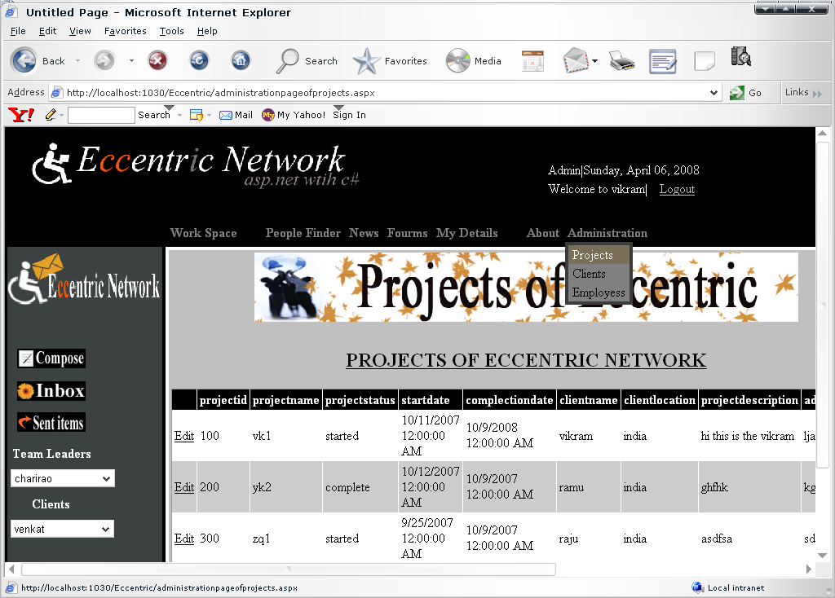

Slide 21
Requirements
Software Requirements
Web-Technologies : ASP.NET
Frameworks : .NET Framework2.0
Database : SQL Server 2005
Web server : IIS 5.0
Language : C#
Hardware Requirements
Operating System : Windows XP Professional SP2
Processor : Pentium 4.0(1.6GHz)
Memory : 512 MB

Slide 22
Conclusion and Enhancements
It provides communication to the team members, team leaders and clients
It will help the members to complete the work with in deadline
It allows the customers to know the project status and send their suggestions
If the organization is made any collaborations then the n/w is adopt easily for that changes

Slide 23
References
Web Sites
[1] http://www.asp.net/
[2] http://www.dotnet-fr.org/
[3].http://www.goole.com/
  Books
  [1] Roger.S.Pressman, Software Engineering. Mc.Graw Hill,
  [2] Apress.Beginning. ASP.NET.2.0.in.C.Sharp.2005. Novice.to.Professional, Jan 2006
  [3] Karumanchi Narayana Rao, Introduction to Microsoft .net.

Slide 24
Thanking You

